Slide 1
Analytics FOR BUSINESS Intelligence
Fall 2021
Nuria Diaz-Tena
Notes:
Attendance and Seating

Slide 2
Course Planning
# | Date | Topic | Assignments | Wg
1 | 9/01/21 | Introduction, Visualizations & Exploratory Data Analysis - Chapter 1
2 | 9/15/21 | Introduction to R
3 | 9/22/21 | Statistical Experiments | Homework #1 - EDA | 5%
4 | 9/29/21 | Regression – Chapter 2 and 3 | Homework #2 -Testing | 5%
5 | 10/06/21 | Inference
6 | 10/13/21 | Models Review
 | 10/20/21 | Midterm Exam | Midterm | 20%
7 | 10/27/21 | Review Midterm and R coding | Project #1 - Regression | 15%
8 | 11/03/21 | Tableau-1 & Classification Models – Chapter 4
9 | 11/10/21 | Bayesian Models | Homework #3 Classification Models | 5%
10 | 11/17/21 | Tableau-2, Bayesian Models lab, Resampling & Advance Classification Models – Chapter 5 to 9
 | 11/24/21 | Thanksgiving Recess
11 | 11/29/21 | Review of Machine Learning Models | Homework #4 - Bayesian Models & install Dataiku | 5%
12 | 12/01/21 | Machine Learning Models Lab
13 | 12/08/21 | Final Exam Preparation | Homework #5 ML | 3%
 | 12/15/21 | Project #2- 2-Tableau, Data manipulation, visualizations, comparisons and modeling |  | 15%
 | 12/15/21 | Final Exam | Final | 20%
 |  |  | Collaboration & attendance | 7%

Slide 3
Agenda:
Review Tableau # 2
Assign Tableau # 3
Review Homework # 3
Clarify Homework #4 – Bayesian Models
Resampling
Machine Learning Models

Slide 4
Tableau Practice # 2
SHAN, XINRUI – Bar Chart: Profit Ratio by city
Build a bar chart of Profit by city, sort it and add labels
Change the tooltip of Profit Ratio by Geography to show cities
ANUSHA– Getting Started with Tableau Prep builder
Upload 2/28th file
Choose Mass Market Tab
Clean data by
Split Info
Split Last Week
Upload 2/21st
Clean
Output Union
Data Relationships
RAMIREZ- What are the best and worst selling products?
JADHAV, ADITYA DILIP - What was the contribution Margin by product?
SAVARAM, ANUSHA - What were the sales revenue, profit and profit margin per category and product?
SHAH, JASH PRASHANT- Who are our most frequent customers?
SHAH, MIHIR SANJAY - Who were our most profitable customers?
SHAH, RUSHABH NIPUL - For which categories did each customer purchase? And in what quantity?

Slide 5
TABLEAU # 3 Use Tableau to visualize the main drivers of Diabetes
What is the Profile of the patients with Diabetes?
Who are they?

Slide 6
Tableau Practice # 3
Market 23
We want to change the data structure of a file. The file includes the market category on the data tab, it has a column for product and has the sales by date in the following columns.
We need a file with all tabs in the same data set with the following variables:
Market
Product
Date
Sales
Product Sum | Sales $ Q3 2018 | Sales $ Q4 2018 | Sales $ Q1 2019
CAVERJECT | $1,039,840 | $1,075,081 | $881,863
CAVERJECT IMPULSE | $1,650,052 | $1,624,702 | $1,365,774
CIALIS | $431,314,989 | $158,640,923 | $106,292,657
EDEX | $2,795,726 | $2,732,182 | $2,818,901
ISOXSUPRINE HCL | $14,405 | $17,054 | $15,436
LEVITRA | $19,983,071 | $17,531,155 | $5,047,222
MUSE | $1,321,099 | $2,168,119 | $1,983,118
ORAVERSE | $100,661 | $51,371 | $246,361
PAPAVERINE HCL | $3,372,097 | $3,970,493 | $4,086,655
PHENTOLAMINE MESY | $1,723,663 | $1,297,337 | $3,724,094
SILDENAFIL CIT | $30,805,704 | $15,548,174 | $12,811,890
STAXYN | $1,341,108 | $729,813 | $336,628
STENDRA | $6,330,770 | $5,778,411 | $4,862,451
TADALAFIL | $6,823,159 | $249,864,407 | $181,413,786
VARDENAFIL HCL |  | $7,899,970 | $11,072,526
VIAGRA | $58,462,139 | $43,086,105 | $33,602,115
YOHIMBE
YOHIMBINE HCL
Grand Total | $567,078,483 | $512,015,297 | $370,561,477

Slide 7
Homework # 3 - Classification Models
Did you include visuals in your presentation?
Did you state the percent of diabetes prevalence in the data?
Is the message clear. In every slide?
Are you providing relevant performance metrics?
Is AIC relevant for categorical models?
Did you include a table comparing models?
Do your conclusions make sense with the performances provided?

Slide 8
Pima.te
Description: A population of women who were at least 21 years old, of Pima Indian heritage and living near Phoenix, Arizona, was tested for diabetes according to World Health Organization criteria. The data were collected by the US National Institute of Diabetes and Digestive and Kidney Diseases. We used the 532 complete records after dropping the (mainly missing) data on serum insulin.
How can you improve your data description?

Slide 9
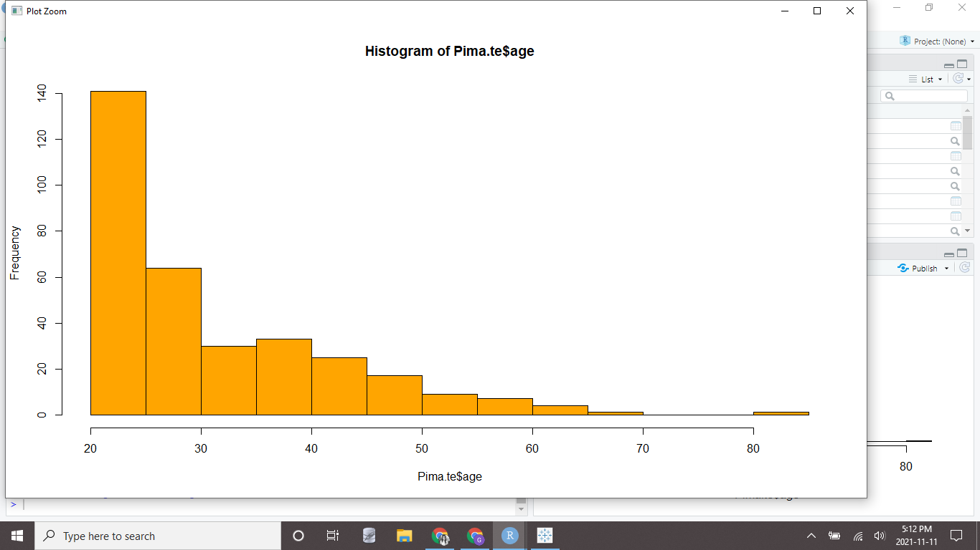
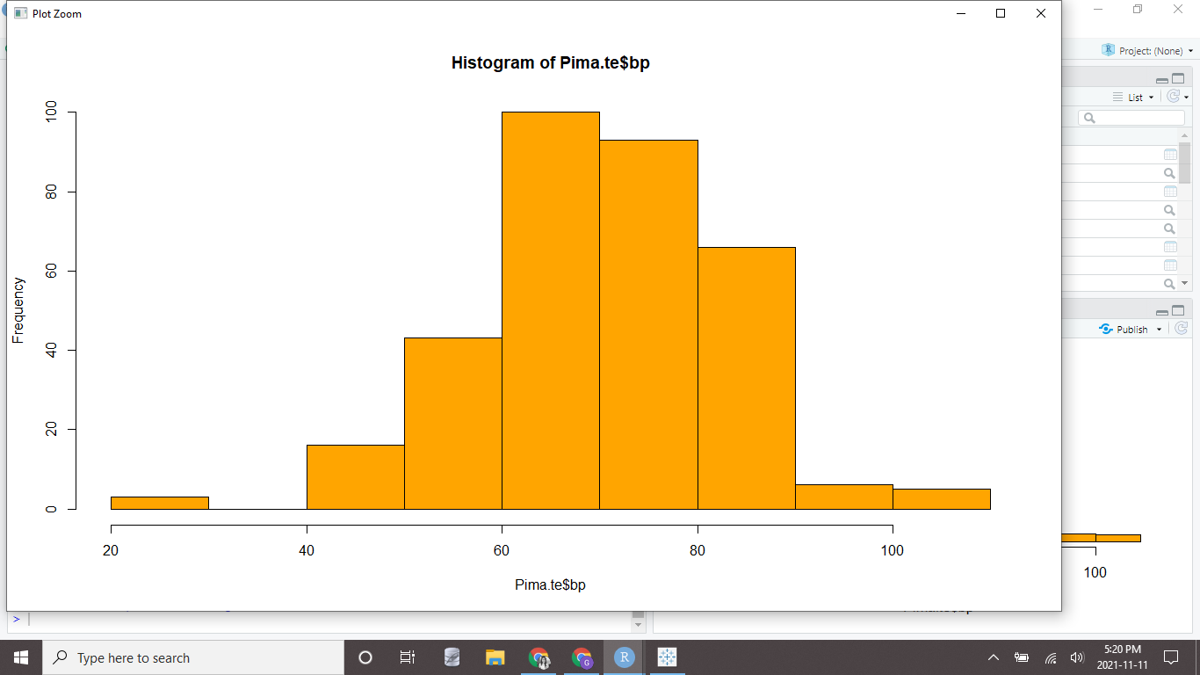
Exploring the dataset
We will now explore the dataset further and observe the characteristics of each variables involved in the survey. This will help us in understanding the dataset better.
On exploring the variable age, we observe that it does not follow a normal distribution as it is skewed to the right with outliers. We can see that the average age is 31 and the median age is 27. Doing the same for Blood Pressure, we can see that the variable is skewed left with outliers. The mean is 71 and median is 72.
How can you improve your data description?

Slide 10
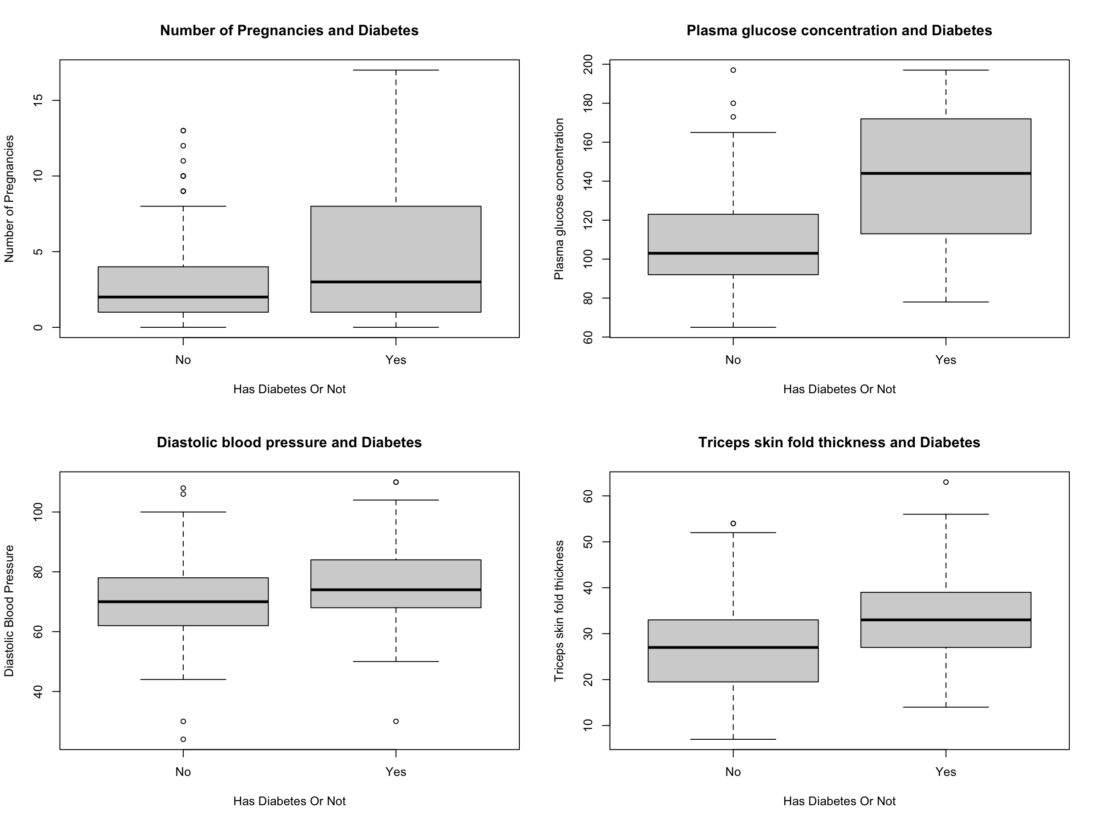
3. Brief summary of the data
The dataset Pima.te has 332 rows 8 columns.
Each column is some independent observations about the Pima Indian women, such as the number of pregnancies, their age and ‘bmi’ etc.
The last column ‘type’ is to judge whether they have diabetes or not.
The boxplot is the relationship between each columns and ‘type’ column.

Slide 11
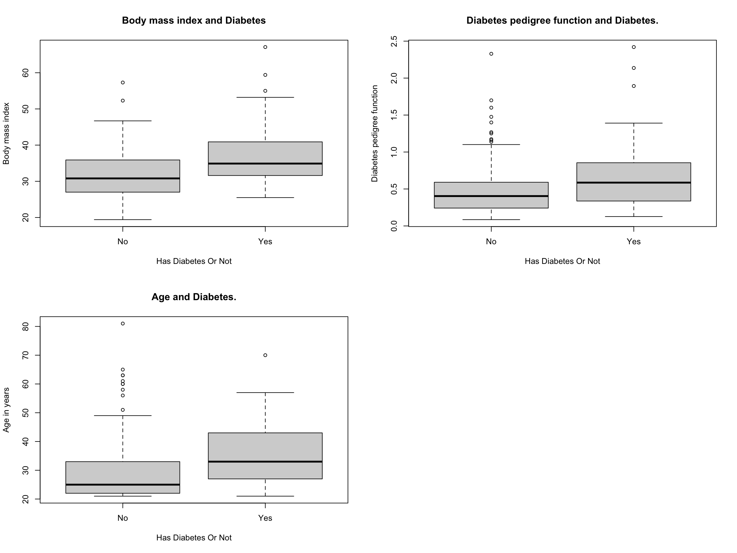

Slide 12
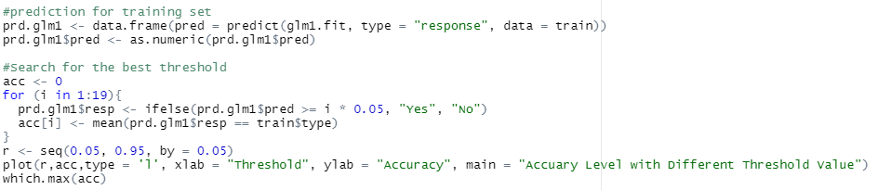
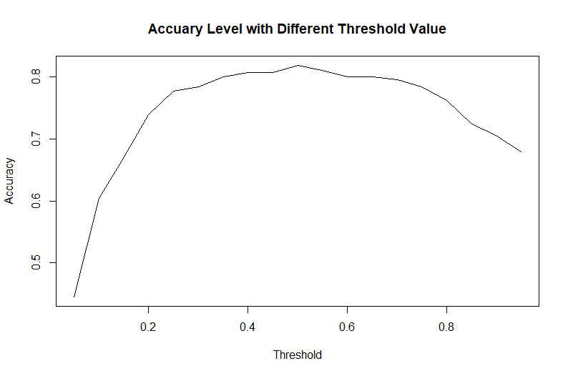
Part ii: LOGISTIC REGRESSION MODEL
Search for the best threshold value of training set prediction
Try different threshold from 0.05 to 0.95
The maximum accuracy in these models is 81.88%
The threshold value is 0.5 accordingly.

Slide 13
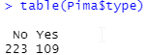
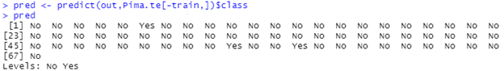
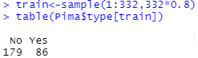
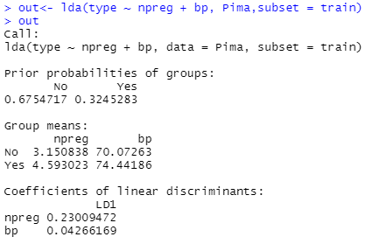
SAMPLING
Model is using 2 variables Npreg & Bp
Accuracy: 0.6716418
P - Value: 5.104e-05

Slide 14
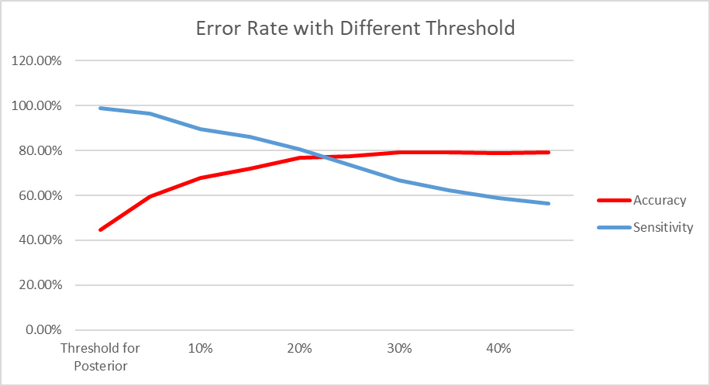
PArt III: LDA & QDA MODEL
Model 6: Try new model with threshold for posterior probability
Notice that the greater of the threshold, higher of the accuracy. However, it also cause the decrease of sensitivity
Thus, we must make a trade-off between accuracy and sensitivity.
At last, we choose p = 0.25 as our best threshold value.

Slide 15
Part III: LDA & QDA MODEL
Testing Set | Actual “No” | Actual “Yes” | Total
Predicted “No” | 39 | 8 | 47
Predicted “Yes” | 6 | 14 | 20
Total | 45 | 22 | 67
Diagnosis for testing set:
Accuracy = 79.10%
Sensitivity = 63.63%
Performs much better than the training set.

Slide 16
MODEL 4, 5 & 6: K - NEAREST NEIGHBOURS
The K-nearest neighbor algorithm creates an imaginary boundary to classify the data. When new data points are added for prediction, the algorithm adds that point to the nearest of the boundary line.
KNN is an instance-based learning algorithm. KNN does not derive any discriminative function from the training table, also there is no training period.
KNN stores the training dataset and uses it to make real-time predictions.
New data can be added seamlessly, and it will not impact the accuracy of the algorithm as there is no training needed for the newly added data.
There are only two parameters required to implement the KNN algorithm i.e., the value of K and the Euclidean distance function.

Slide 17
Prar V: MODEL SUMMARY
No | Variables Included | Method | Accuracy | Sensitivity
1 | glu, bmi, ped, age | Logistic Reg | 74.63% | 59.10%
2 | glu, bmi, ped, age preg | Forward Reg | 74.63% | 59.10%
3 | glu, bmi, ped, age preg | Backword Reg | 74.63% | 59.10%
4 | npreg, glu, bp, skin, bmi, ped, age | LDA | 73.13% | 54.54%
5 | glu, bp, skin, bmi, ped | LDA | 79.10% | 54.54%
6 | glu, bp, skin, bmi, ped Posterior Prob Threshold = 0.25 | LDA | 76.12% | 72.72%
7 | glu, bp, skin, bmi, ped | QDA | 79.10% | 63.63%
8 | glu, bmi * | K-NN | 83.58% | 92.31%
*There are 4 best KNN models with different variables, here is only one of them
Obviously, our champion is K-Nearest Neighbors Model
With an Accuracy of 83.58% and a Sensitivity of 92.31%

Slide 18
Final Findings
On comparing the accuracies of all the model, we find that the QDA model has the highest accuracy considering all the attributes with reference to Type i.e., weather a woman has Diabetes or not come out to be 80.72%.
From here, we can conclude that the best model to predict the Pima.te dataset is the QDA i.e. Quadratic Discriminant Model.
Model | Accuracy
GLD 1 | 76.11 %
GLD 2 | 73.13 %
LDA | 74.63 %
QDA | 80.72 %
KNN 1 | 71.64 %
KNN 2 | 74.62 %

Slide 19
Moderate Accuracy range from 70% to 81%
Metrics: Accuracy
Teams H and K are underperforming
These are the average performances:
LDA. 82%
Logistic 81%
KNN. 78%
QDA 69%

Slide 20
Homework #4 Bayesian Models
Provide an executive summary
State an overview of the problem to solve (Background)
Explain how you are going to solve the problem and why you should do it this way
Provide a short summary of the data
Provide the MAPE of the model with a visual in the training set and the hold out period
Provide the ROIs for 2019
Provide mROIs for 2019
Provide response curves Predicted sales (y-axes) and spend (x-axes)
Provide various scenarios with optimal spend for the next year:
Scenario 1: Same spend as in 2019
Scenario 2: Increasing spend by 25%
Scenario 3: Reducing spend by 25%
Provide a power point presentation

Slide 21
REsampling

Slide 22
Goal of Resampling
Goal – Select the best model
How can we automatically choose the best model? – Using resampling methods.
Resampling methods involve repeatedly drawing samples from a training set, evaluating the model in the testing set and choosing the model with the best model assessment (performance)
Classified data
Universe
Training data 80%
Testing data 20%

Slide 23
Goal and Types of Resampling
Resampling methods involve repeatedly drawing samples from a training set and refitting a model of interest on each sample in order to obtain additional information about the fitted model.
Cross-validation
Leave-One-Out Cross-Validation
K-Fold Cross-Validation
Bootstrap

Slide 24
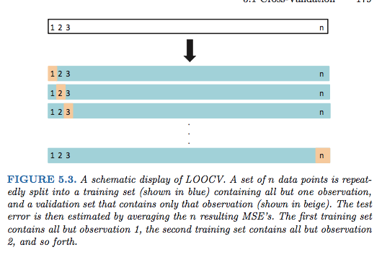
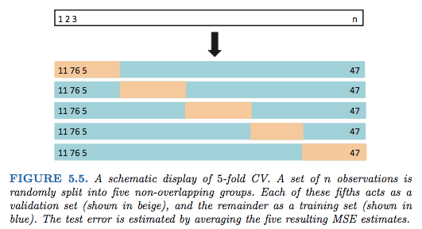
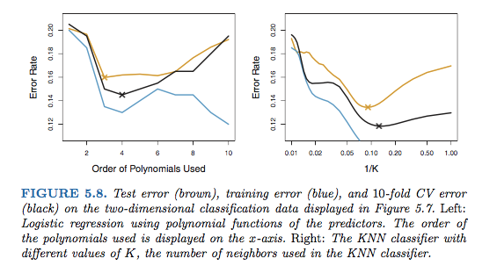
Cross-Validation
Leave-One-Out Cross-Validation
K-Fold Cross-Validation

Slide 25
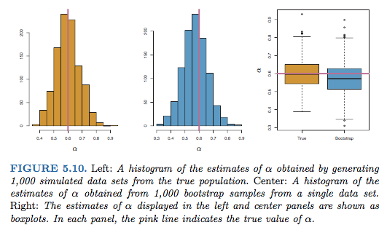
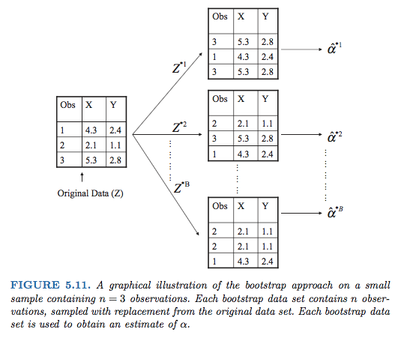
Bootstrap
Difference between sampling many times to Bootstrapping

Slide 26
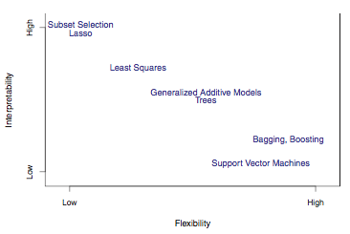
Machine Learning Models use resampling and Non-parametric Models
Non-Parametric Model
F (X) = any model form of x flexible model

Slide 27
Model Selection

Slide 28
Model Selection
What is model assessment? The process of evaluating a model’s performance
What is model selection? The process of selecting the proper level of flexibility
cross-validation can be used to estimate the test error associated with a given statistical learning method in order to evaluate its performance, or to select the appropriate level of flexibility.
Bootstrap is used in several contexts, most commonly to provide a measure of accuracy of a parameter estimate or of a given statistical learning method

Slide 29
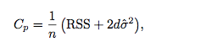
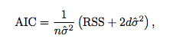
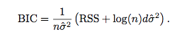
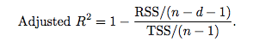
Model Performance on the testing set
Numerical Response
Categorical Response
Mallows Cp
Accuracy
Precision
Recall
F1
Kappa - improve classification if the percentage to predict is small
Akaike information criterion (AIC)
Bayesian information criterion(BIC)
MAPE.

Slide 30
Confusion Matrix Results - 1
#Creating confusion matrix
library(confusionMatrix)
#Creating confusion matrix
confusionMatrix(data = testset$pred,
reference = testset$obs)
Confusion Matrix and Statist
Reference
Prediction Class1 Class2
Class1 183 141
Class2 13 663
Accuracy : 0.846 # (183+663)/1,000
95% CI : (0.8221, 0.8678)
No Information Rate : 0.804 # The largest proportion of the observed classes: (141+663)/1,000
P-Value [Acc > NIR] : 0.0003424
Kappa : 0.6081
Mcnemar's Test P-Value : 2.2e-16 # Hypothesis: Models have similar proportion of error in two groups
Sensitivity : 0.9337 # Same as recall Pct Pos predicted correctly 183/(183+13)
Specificity : 0.8246 # Pct Neg predicted correctly 663/(141+663)
Pos Pred Value : 0.5648 #Sensitivity*Prevalence/(Sensitivity*Prevalence+(1-specificity)*(1-Prevalence))
Neg Pred Value : 0.9808 #Specificity*(1-Prevalence)/((1-Sensitivity)*Prevalence+Specificity)*(1-Prevalence))
Prevalence : 0.1960 # Pct True Positive (183+13)/1,000
Detection Rate : 0.1830 # The rate of Pos correctly predicted events 183/1,000
Detection Prevalence : 0.3240 # Prevalance of predicted events (183+141)/1,000 Balanced Accuracy : 0.8792 # Average between sensitivity and specificity
'Positive' Class : Class1

Slide 31
Confusion Matrix Results - 2
#Creating confusion matrix
library(confusionMatrix)
#Creating confusion matrix
confusionMatrix(data = testset$pred,
reference = testset$obs,
mode = prec_recall)
Confusion Matrix and Statistics
Reference””
Prediction Class1 Class2
Class1 183 141
Class2 13 663
Accuracy : 0.846 # (183+663)/1,000
95% CI : (0.8221, 0.8678)
No Information Rate : 0.804 # The largest proportion of the observed classes: (141+663)/1,000
P-Value [Acc > NIR] : 0.0003424
Kappa : 0.6081
Mcnemar's Test P-Value : 2.2e-16
Precision : 0.5648 # Pct Pos predicted correctly among positive predictions 183/(183+141)
Recall : 0.9337 # Same as Sensitivity Pct Pos predicted correctly 183/(183+13)
F1: 0.7038 # (1+ Beta²)*Precision* Recall/(Beta²*Precision+Recall)
Prevalence : 0.1960 # Pct True Positive (183+13)/1,000
Detection Rate : 0.1830 # The rate of Pos correctly predicted events 183/1,000
Detection Prevalence : 0.3240 # Prelevance of predicted events (183+141)/1,000
Balanced Accuracy : 0.8792 # Average between sensitivity and specificity
'Positive' Class : Class1

Slide 32
Feature Selection or Variable Selection
Goal of the Feature Selection
Avoid over-fitting the model in the training data set and obtaining a better accuracy on the testing data set.
After identifying p significant predictors.
Subset selection
Fit models using least squares in a reduced set of variables
Best subset selection
Forward Stepwise selection
Backward stepwise selection
Hybrid approach
Shrinkage
Shrink the significant coefficients towards zero and estimate the posteriors after shrinkage. Do not use the coefficients that remain zero after the shrinkage.
Ridge regression
Lasso
Dimension Reduction
Project the p predictors into an M dimensional subspace. Fit those M projections using least squares

Slide 33
Other Classification Models
Trees
Decision Tree
Random Forest
Gradient Boosted Trees
XGBoost
Extra Random Trees
Non-Linear
KNN
Support Vector Machines
Stochastic Gradient Descent
Neural Networks
Linear
Logistic
LDA
QDA

Slide 34
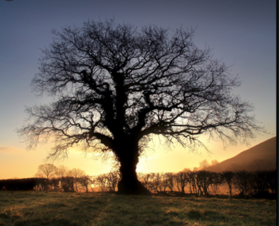
Trees

Slide 35
Decision Tree
Decision Trees
Decision Tree is a simple non-parametric algorithm. It creates a model that predicts the value of the target by learning simple decision rules inferred from the data features.
These rules form a tree, with the leaves of the tree carrying the predicted class. Evaluation simply goes down the tree and evaluates the rule at each split.
Flexibility and explainability.
Can the model be improved by using more than 1 TREE?

Slide 36
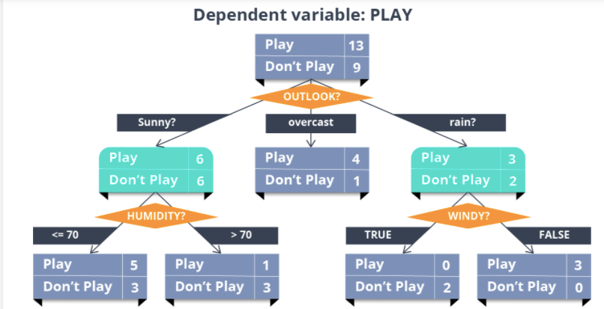
Decision Trees
What is a Decision Tree?
A decision tree is a map of the possible outcomes of a series of related choices. It uses a tree-like model of decisions. A decision tree typically starts with a single node, which branches into possible outcomes. Each of those outcomes leads to additional nodes, which branch off into other possibilities. This gives it a tree-like shape.
59%
50%
60%
80%
62.5%
25%
0%
100%

Slide 37
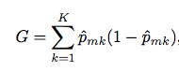
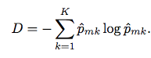
Decision Trees nodes metrics
Gini Index
A measure of the total variance among the K classes.
The Gini index takes a small value if the p are close to zero or one. The Gini index is preferred to as the measure of node purity.
Entropy
An alternative to the Gini index is entropy
it turns out that the Gini index and the entropy are quite similar numerically.
When building a classification tree, either the Gini index or the entropy are typically used to evaluate the quality of a particular split
Advantage of decision Trees: Easy to explain

Slide 38
Decision Tree Choices
Maximum depth: (5)
Criterion: (Gini, Entropy)
Min. samples per leaf: (1)
Split strategy: (Best, Random)
The maximum depth of the tree.
The function to measure the quality of a split. Supported criteria are “gini” for the Gini impurity and “entropy” for the information gain.
Minimum number of samples required to be at a leaf node.
The strategy used to choose the split at each node. Supported strategies are “best” to choose the best split and “random” to choose the best random split.

Slide 39
Random Forest
Decision Trees
A Random Forest is made of many decision trees. Each tree in the forest predicts a record, and each tree "votes" for the final answer of the forest.
The forest chooses the class having the most votes.
Cross Validation and Feature Selection?
A random sample of the training set is used for each tree.
For each decision point in the tree, a random subset of the input features is considered.
Flexibility versus explainability?
Random Forests generally provide good results, at the expense of
"explainability" of the model.

Slide 40
Random Forest Choices
Number of trees
(100, 50, etc.)
Feature Sampling Strategy
(Square root, Logarithm, Fix Number, Fix Proportion)
Maximum depth of tree
(6, 21, 14)
Minimum samples per leaf
(3, 50, 25)
Parallelism
(4)
Number of trees in the forest.
Adjusts the number of features to sample at each split.
Maximum depth of each tree in the forest. Higher values generally increase the quality of the prediction, but can lead to overfitting. High values also increase the training and prediction time. Use 0 for unlimited depth (ie, keep splitting the tree until each node contains a single target value)
Minimum number of samples required in a single tree node to split this node. Lower values increase the quality of the prediction (by splitting the tree mode), but can lead to overfitting and increased training and prediction time.
Number of cores used for parallel training. Using more cores leads to faster training but at the expense of more memory consumption, especially for large training datasets.

Slide 41
Extra Random Trees
Decision Trees or Linear Model or Non-Linearity
Extra trees, just like Random Forests, are an ensemble model. In addition to sampling features at each stage of splitting the tree, it also samples random threshold at which to make the splits. The additional randomness may improve the ability of the model to generalize (compared to a random forest) and may yield better results.
Cross Validation and Feature Selection?
Yes and yes
Flexibility versus explainability?

Slide 42
Extra Random Trees Choices
Number of trees: (30)
Feature sampling strategy
(Automatic (30%), Square Root, Logarithm, Fix Number, Fix Proportion)
Maximum depth of tree: (8)
Minimum samples per leaf: (3)
Parallelism
Number of trees in the forest.
Adjusts the number of features to sample at each split.
Maximum depth of each tree in the forest. Higher values generally increase the quality of the prediction, but can lead to overfitting. High values also increase the training and prediction time. Use 0 for unlimited depth (ie, keep splitting the tree until each node contains a single target value)
Minimum number of samples required in a single tree node to split this node. Lower values increase the quality of the prediction (by splitting the tree mode), but can lead to overfitting and increased training and prediction time.
Number of cores used for parallel training. Using more cores leads to faster training but at the expense of more memory consumption, especially for large training datasets.

Slide 43
XGBoost
Decision Trees or Linear Model
XGBoost is an advanced gradient tree boosting algorithm. It has support for parallel processing, regularization and early stopping, which makes it a fast, scalable and accurate algorithm.
For more information on gradient tree boosting, see the "Gradient tree boosting" algorithm.
Cross Validation and Feature Selection?
Yes and yes
Flexibility versus explainability?

Slide 44
XGBoost Choices - 1
Booster
(Gradient Boosted Trees, DART)
Tree method
(Automatic, Exact, Approximate, Histogram)
GPU acceleration: (Yes, No)
Maximum number of trees
(100 – 10000)
Early stopping: (Yes, No)
Early stopping rounds:
(Yes, No)
Maximum depth of tree:
(8, 14, 3)
Learning rate: (0.2 , 0.1)
'DART' is a variant of the 'Gradient Boosted Trees' estimator where, at each step of the training phase, previous trees are randomly dropped out.
'Automatic' will chose one of the other method based on heuristic and shape of the data.
'Exact' is a greedy tree-building algorithm.
'Approximate' is a fast tree-building algorithm.
'Histogram' is an optimized fast tree-building algorithm.
To enable GPU support in XGBoost, please select a custom Python code environment with an installation of XGBoost that supports computations on GPUs.
XGBoost has an early stop mechanism so the exact number of trees will be optimized. High number of actual trees will increase the training and prediction time. Typical values: 100 – 10000
Use XGBoost built-in early stop mechanism so the exact number of trees will be optimized.
The cross-validation scheme defined in the "Hyperparameters" tab will be used.
The optimizer stops if the loss never decreases for this consecutive number of iterations. Typical values: 1 – 100
Maximum depth of each tree. High values can increase the quality of the prediction, but can lead to overfitting. Typical values: 3 – 10
Lower values slow down convergence and can make the model more robust. Typical values: 0.01 - 0.3

Slide 45
XGBoost Choices - 2
L2 regularization: (1)
L1 regularization: (0)
Gamma: (0)
Minimum child weight: (0)
Subsample: (0.8, 0.2)
Colsample by tree: (0.8, 0.2)
Replace missing values
(Yes, No)
Parallelism: (4)
Decision Tree
Decision Tree is a simple non-parametric algorithm. It creates a model that predicts the value of the target by learning simple decision rules inferred from the data features.
These rules form a tree, with the leaves of the tree carrying the predicted class. Evaluation simply goes down the tree and evaluates the rule at each split.
Show less…
Maximum depth
5
The maximum depth of the tree.
Criterion
Try GiniTry Entropy
The function to measure the quality of a split. Supported criteria are “gini” for the Gini impurity and “entropy” for the information gain.
Min. samples per leaf
1
Minimum number of samples required to be at a leaf node.
Split strategy
Try BestTry Random
The strategy used to choose the split at each node. Supported strategies are “best” to choose the best split and “random” to choose the best random split.
Support Vector Machine
Support Vector Machine is a powerful (but very slow) 'black-box' algorithm for classification.
Through the use of kernel functions, it can learn complex non-linear decision boundaries (i.e., when it is not possible to compute the target as a linear combination of input features).
SVM is effective with a large number of features. However, this algorithm is generally much slower than others and is generally not practical with more than a few thousand records.
Show less…
Kernel
Try with a linear kernel Try with a RBF kernel Try with a polynomial kernel Try with a sigmoid kernel
C
1
Penalty parameter C of the error term.
A low value of C will generate a smoother decision boundary (higher bias) while a high value aims at correctly classifying all training examples, at the risk of overfitting (high variance).
(C corresponds to the inverse of a regularization parameter).
Gamma
Try with 1/nb_features (auto)
A low value of C will generate a smoother decision boundary (higher bias) while a high value aims at correctly classifying all training examples, at the risk of overfitting (high variance).
(C corresponds to the inverse of a regularization parameter).
Gamma
Try with 1/nb_features (auto)Try with 1/(nb_features * variance) (scale) Try with custom gamma values
Kernel coefficient for RBF, polynomial and sigmoid kernels.
Gamma defines the 'influence' of each training example in the features space.
A low value of gamma means that each example has 'far-reaching influence', while a high value means that each example only has close-range influence.
Tolerance
Tolerance for stopping criterion, i.e. variation on loss below which the algorithm stops training. Should be a positive number.
Maximum number of iterations
-1 = unlimited
Stochastic Gradient Descent
SGD is a family of algorithms that reuse concepts from Support Vector Machines and Logistic Regression.
SGD uses an optimized method to minimize the cost (or loss) function, making it particularly suitable for large datasets (or datasets with large number of features).
Show less…
Loss function
Try Logit loss Try Modified Huber Loss
Selecting 'logit' loss will make the SGD behave like a Logistic Regression.
Enabling 'modified huber' loss will make the SGD behave quite like a Support Vector Machine
Max. Iterations
Maximum number of iterations on the train data
Tolerance
Tolerance for stopping criterion, i.e. variation on loss below which the algorithm stops training. Should be a positive number.
Penalty
Try L1 regularization Try l2 regularization Try ElasticNet regularization
L1 and L2 regularizations are similar to the ones for Logistic Regression.
L1 and L2 regularizations are similar to the ones for Logistic Regression.
ElasticNet regularization combines both a L1 and L2 regularization.
Alpha
0.001
0.0001
0.00001
Regularization parameter.
A high value of alpha (ie, more regularization) will generate a smoother decision boundary (higher bias) while a lower value (less regularization) aims at correctly classifying all training examples, at the risk of overfitting (high variance)
Parallelism
Number of cores used for parallel training. Using more cores leads to faster training but at the expense of more memory consumption, especially for large training datasets. (-1 means 'all cores')
K Nearest Neighbors
K Nearest Neighbors makes predictions for a sample by finding the k nearest samples and assigning the most represented class among them.
Warning: this algorithm requires storing the entire training data into the model. This will lead to a very large model if the data is larger than a few hundred lines. Predictions will also be slow.
Show less…
K
5
The number of neighbors to examine for each sample.
Distance weighting
Use distance weighting
If enabled, voting across neighbors will be weighed by the inverse distance from the sample to the neighbor.
Neighbor finding algorithm
Automatic
The method used to find the nearest neighbors to each point. Has no impact on predictive performance, but will have a high impact on training and prediction speed.
p
The exponent of the Minkowski metric used to search neighbors. For p = 2, this gives Euclidian distance, for p = 1, Manhattan distance. Greater values lead to the Lp distances.
Extra Random Trees
Extra trees, just like Random Forests, are an ensemble model. In addition to sampling features at each stage of splitting the tree, it also samples random threshold at which to make the splits. The additional randomness may improve the ability of the model to generalize (compared to a random forest) and may yield better results.
Show less…
Number of trees
30
Number of trees in the forest.
Feature sampling strategy
Default
Adjusts the number of features to sample at each split.
Maximum depth of tree
8
Maximum depth of each tree in the forest. Higher values generally increase the quality of the prediction, but can lead to overfitting. High values also increase the training and prediction time. Use 0 for unlimited depth (ie, keep splitting the tree until each node contains a single target value)
Minimum samples per leaf
3
Minimum number of samples required in a single tree node to split this node. Lower values increase the quality of the prediction (by splitting the tree mode), but can lead to overfitting and increased training and prediction time.
Minimum number of samples required in a single tree node to split this node. Lower values increase the quality of the prediction (by splitting the tree mode), but can lead to overfitting and increased training and prediction time.
Parallelism
Number of cores used for parallel training. Using more cores leads to faster training but at the expense of more memory consumption, especially for large training datasets.
Neural Network
Neural Networks are a class of parametric models which are inspired by the functioning of the neurons. They consist of several "hidden" layers of neurons, which receive inputs and transmit them to the next layer, mixing the inputs and applying non-linearities, allowing for a complex decision function.
Show less…
Hidden layer sizes
10
Number of neurons on each hidden layer. Add one value per layer
Activation
ReLU
The activation function for the neurons in the network.
Alpha
L2 regularization parameter. Higher values lead to smaller neuron weights and a more generalizable, although less sharp model.
Max iterations
Maximum iterations for learning. Higher values lead to better convergence, but take more time.
Convergence tolerance
If the loss does not improve by this ratio over two iterations, training stops.
Early stopping
Whether the model should use validation and stop early.
Solver
ADAM
The solver to use for optimization. LBFGS is a batch algorithm and is not suited for larger datasets.
Shuffle data
Whether the data should be shuffled between epochs (recommended, unless the data is already in random order).
Intial Learning Rate
The initial learning rate for gradient descent.
Automatic batching
Whether batches should be created automatically (will use 200, or the whole dataset if there are less samples). Uncheck to select batch size.
beta_1
beta_1 parameter for ADAM.
beta_2
beta_2 parameter for ADAM.
epsilon
epsilon parameter for ADAM.
Lasso Path
Lasso Path is a method which uses a linear model with a L1 regularization and computes the LASSO path (ie. for all values of the regularization parameter).
This computation allows to select a given number of non-zero coefficients, ie. to select a given number of features. After training, you will be able to visualize the LASSO path and select a new number of features.
This is performed using LARS regression. It requires a number of passes on the data equal to the number of features. If this number is large, computation may be slow.
Show less…
Maximum features
The number of kept features. Input 0 to have all features enabled (no regularization). Has no impact on training time.
Number of tests
The number of values of the regularization parameter to test. The path will be extrapolated from the resulting coefficients. Increases training time linearly.
’
Minimum loss reduction to split a leaf.
Minimum sum of weights(hessian) in a node. High values can prevent overfitting by learning highly specific cases. Smaller values allow leaf nodes to match a small set of rows, which can be relevant for highly imbalanced sets.
Subsample ratio for the data to be used in each tree. Low values can prevent overfitting but can make specific cases harder to learn. Typical values: 0.5 – 1
Fraction of the features to be used in each tree. Typical values: 0.5-1
Number of cores used for parallel training. Using more cores leads to faster training but at the expense of more memory consumption, especially for large training datasets. (-1 means 'all cores')

Slide 46
Gradient Boosted Trees
Decision Trees or Linear Model
Gradient boosting is a technique which produces a prediction model in the form of an ensemble of "weak" prediction models (small decision trees). The concept is to train a set of decision trees (weak learners) to create a final strong learner. This is an iterative method. After each tree is trained, the data is reweighted: samples that were misclassified gain weight while the correctly classified ones lose weight. This allows future weak learners to focus on the "difficult" examples that the previous weak learners missed. Gradient Boosted Trees is a generalization of boosting to arbitrary differentiable loss functions. GBT is an accurate and effective off-the-shelf procedure that can be used for both regression and classification problems. Advantages: Natural handling of data of mixed type (= heterogeneous features), Predictive power and Robustness to outliers in output space (via robust loss functions)
Disadvanages: Due to the iterative nature of boosting, it is not very parallelizable and is less scalable than other algorithms.
Cross Validation and Feature Selection?
Yes and yes
Flexibility versus explainability?

Slide 47
Gradient Boosted Trees Choices
Number of boosting stages
(100 )
Feature sampling strategy
(Automatic (30%), Square Root, Logarithm, Fix Number, Fix Proportion)
Learning rate
(0.1)
Loss
(Deviance, Exponential
Maximum depth of tree
(3 )
The number of boosting stages to perform.
Gradient boosting is fairly robust to over-fitting so a large number usually results in better performance.
Adjusts the number of features to sample at each split.
Learning rate shrinks the contribution of each tree by `learning_rate`.
There is a trade-off between learning_rate and n_estimators.
Deviance refers to deviance (= logistic regression) for classification with probabilistic outputs.
For loss 'exponential', gradient boosting recovers the AdaBoost algorithm.
Maximum depth of the individual regression estimators.
The maximum depth limits the number of nodes in the tree.
Tune this parameter for best performance; the best value depends on the interaction of the input variables.

Slide 48
Support Vector Machines
Decision Trees or Linear Model or Non-Linearity
Support Vector Machine is a powerful (but very slow) 'black-box' algorithm for classification.
Through the use of kernel functions, it can learn complex non-linear decision boundaries (i.e., when it is not possible to compute the target as a linear combination of input features).
SVM is effective with a large number of features.
Cross Validation and Feature Selection?
Yes and yes
Flexibility versus explainability?

Slide 49
Support Vector Machine Choices
Kernel
linear kernel
RBF kernel
Polynomial kernel
Sigmoid kernel
C: (1)
Gamma (RBF, Polynomial & Sigmoid Kernel)
1/nb_features
1/(nb_features * variance
custom gamma values
Coef0
Tolerance: (0.001)
Maximum Number of Interactions: (-1)
Penalty parameter C of the error term.
A low value of C will generate a smoother decision boundary (higher bias) while a high value aims at correctly classifying all training examples, at the risk of overfitting (high variance).
(C corresponds to the inverse of a regularization parameter).
Kernel coefficient for RBF, polynomial and sigmoid kernels.
Gamma defines the 'influence' of each training example in the features space.
A low value of gamma means that each example has 'far-reaching influence', while a high value means that each example only has close-range influence.
Coef0 is ann independent term for Polynomial nad Sigmoid Kernel functions
Tolerance for stopping criterium, i.e. variation on loss below the algorithm stops training. Should be a positive number
1 is Unlimited

Slide 50
Stochastic Gradient Descent
Decision Trees or Linear Model or Non-Linearity
SGD is a family of algorithms that reuse concepts from Support Vector Machines and Logistic Regression.
SGD uses an optimized method to minimize the cost (or loss) function, making it particularly suitable for large datasets (or datasets with large number of features).
Cross Validation and Feature Selection?
Yes and yes
Flexibility versus explainability?

Slide 51
Stochastic Gradient Descent Choices
Loss function
(Logit loss, Modified Huber Loss)
Max. Iterations (1000)
Tolerance
Penalty
L1 regularization
l2 regularization
ElasticNet regularization
Alpha: (0.001, 0.0001, 0.00001)
Parallelism
K Nearest Neighbors
K Nearest Neighbors makes predictions for a sample by finding the k nearest samples and assigning the most represented class among them.
Warning: this algorithm requires storing the entire training data into the model. This will lead to a very large model if the data is larger than a few hundred lines. Predictions will also be slow.
Show less…
K
5
The number of neighbors to examine for each sample.
Distance weighting
Use distance weighting
If enabled, voting across neighbors will be weighed by the inverse distance from the sample to the neighbor.
Neighbor finding algorithm
Automatic
The method used to find the nearest neighbors to each point. Has no impact on predictive performance, but will have a high impact on training and prediction speed.
p
The exponent of the Minkowski metric used to search neighbors. For p = 2, this gives Euclidian distance, for p = 1, Manhattan distance. Greater values lead to the Lp distances.
Extra Random Trees
Extra trees, just like Random Forests, are an ensemble model. In addition to sampling features at each stage of splitting the tree, it also samples random threshold at which to make the splits. The additional randomness may improve the ability of the model to generalize (compared to a random forest) and may yield better results.
Show less…
Number of trees
30
Number of trees in the forest.
Feature sampling strategy
Default
Adjusts the number of features to sample at each split.
Maximum depth of tree
8
Maximum depth of each tree in the forest. Higher values generally increase the quality of the prediction, but can lead to overfitting. High values also increase the training and prediction time. Use 0 for unlimited depth (ie, keep splitting the tree until each node contains a single target value)
Minimum samples per leaf
3
Minimum number of samples required in a single tree node to split this node. Lower values increase the quality of the prediction (by splitting the tree mode), but can lead to overfitting and increased training and prediction time.
Minimum number of samples required in a single tree node to split this node. Lower values increase the quality of the prediction (by splitting the tree mode), but can lead to overfitting and increased training and prediction time.
Parallelism
Number of cores used for parallel training. Using more cores leads to faster training but at the expense of more memory consumption, especially for large training datasets.
Neural Network
Neural Networks are a class of parametric models which are inspired by the functioning of the neurons. They consist of several "hidden" layers of neurons, which receive inputs and transmit them to the next layer, mixing the inputs and applying non-linearities, allowing for a complex decision function.
Show less…
Hidden layer sizes
10
Number of neurons on each hidden layer. Add one value per layer
Activation
ReLU
The activation function for the neurons in the network.
Alpha
L2 regularization parameter. Higher values lead to smaller neuron weights and a more generalizable, although less sharp model.
Max iterations
Maximum iterations for learning. Higher values lead to better convergence, but take more time.
Convergence tolerance
If the loss does not improve by this ratio over two iterations, training stops.
Early stopping
Whether the model should use validation and stop early.
Solver
ADAM
The solver to use for optimization. LBFGS is a batch algorithm and is not suited for larger datasets.
Shuffle data
Whether the data should be shuffled between epochs (recommended, unless the data is already in random order).
Intial Learning Rate
The initial learning rate for gradient descent.
Automatic batching
Whether batches should be created automatically (will use 200, or the whole dataset if there are less samples). Uncheck to select batch size.
beta_1
beta_1 parameter for ADAM.
beta_2
beta_2 parameter for ADAM.
epsilon
epsilon parameter for ADAM.
Lasso Path
Lasso Path is a method which uses a linear model with a L1 regularization and computes the LASSO path (ie. for all values of the regularization parameter).
This computation allows to select a given number of non-zero coefficients, ie. to select a given number of features. After training, you will be able to visualize the LASSO path and select a new number of features.
This is performed using LARS regression. It requires a number of passes on the data equal to the number of features. If this number is large, computation may be slow.
Show less…
Maximum features
The number of kept features. Input 0 to have all features enabled (no regularization). Has no impact on training time.
Number of tests
The number of values of the regularization parameter to test. The path will be extrapolated from the resulting coefficients. Increases training time linearly.
Selecting 'logit' loss will make the SGD behave like a Logistic Regression.
Enabling 'modified huber' loss will make the SGD behave quite like a Support Vector Machine
Maximum number of iterations on the train data
Tolerance for stopping criterion, i.e. variation on loss below which the algorithm stops training. Should be a positive number.
L1 and L2 regularizations are similar to the ones for Logistic Regression.
ElasticNet regularization combines both a L1 and L2 regularization.
Regularization parameter.
A high value of alpha (ie, more regularization) will generate a smoother decision boundary (higher bias) while a lower value (less regularization) aims at correctly classifying all training examples, at the risk of overfitting (high variance)
Number of cores used for parallel training. Using more cores leads to faster training but at the expense of more memory consumption, especially for large training datasets. (-1 means 'all cores')

Slide 52
Neural Networks
Decision Trees or Linear Model or Non-Linearity
Neural Networks are a class of parametric models which are inspired by the functioning of the neurons. They consist of several "hidden" layers of neurons, which receive inputs and transmit them to the next layer, mixing the inputs and applying non-linearities, allowing for a complex decision function.
Cross Validation and Feature Selection?
Yes and yes
Flexibility versus explainability?

Slide 53
Neural Networks Choices
Hidden layer sizes: (10)
Activation
ReLU
Identity
Logistic
Hyperbolic Tangent
Alpha: (0.001)
Max iterations: (200)
Convergence tolerance: (0.0001)
Early stopping (Yes, No)
Solver
ADAM
Stochastic Gradient Descent
LBFGS
Shuffle data (Yes, No)
Initial Learning Rate (0.001)
Automatic batching (yes, No)
beta_1 (0.9)
beta_2 (0.999)
Epsilon (1e-8)
Number of neurons on each hidden layer. Add one value per layer
The activation function for the neurons in the network.
L2 regularization parameter. Higher values lead to smaller neuron weights and a more generalizable, although less sharp model.
Maximum iterations for learning. Higher values lead to better convergence, but take more time.
If the loss does not improve by this ratio over two iterations, training stops.
Whether the model should use validation and stop early.
The solver to use for optimization. LBFGS is a batch algorithm and is not suited for larger datasets.
Whether the data should be shuffled between epochs (recommended, unless the data is already in random order).
The initial learning rate for gradient descent.
Whether batches should be created automatically (will use 200, or the whole dataset if there are less samples). Can select batch size.
beta_1 parameter for ADAM.
beta_2 parameter for ADAM.
epsilon parameter for ADAM.

Slide 54
Logistic Regression
Decision Trees or Linear Model
Despite its name, Logistic Regression is a classification algorithm, using a linear model (i.e., it computes the target feature as a linear combination of input features).
Logistic Regression minimizes a specific cost function (called logit or sigmoid function), which makes it appropriate for classification.
A simple Logistic regression algorithm is prone to overfitting and sensitive to errors in the input dataset. To address these issues, it is possible to use a penalty (or regularization term) to the weights.
This implementation can use either 'L1' or 'L2' regularization terms.
Cross Validation and Feature Selection?
Yes and yes
Flexibility versus explainability?

Slide 55
Lasso Path
Decision Trees or Linear Model or Non-Linearity
Lasso Path is a method which uses a linear model with a L1 regularization and computes the LASSO path (ie. for all values of the regularization parameter).
This computation allows to select a given number of non-zero coefficients, ie. to select a given number of features. After training, you will be able to visualize the LASSO path and select a new number of features.
This is performed using LARS regression. It requires a number of passes on the data equal to the number of features. If this number is large, computation may be slow.
Cross Validation and Feature Selection?
Yes and yes
Flexibility versus explainability?

Slide 56
K Nearest Neighbor
Decision Trees or Linear Model or Non-Linearity
K Nearest Neighbors makes predictions for a sample by finding the k nearest samples and assigning the most represented class among them.
Warning: this algorithm requires storing the entire training data into the model. This will lead to a very large model if the data is larger than a few hundred lines. Predictions will also be slow.
Cross Validation and Feature Selection?
Yes and yes
Flexibility versus explainability?

Slide 57
K Nearest Neighbor Choices
K: (5)
Distance weighting
Use distance weighting (Yes, No)
Neighbor finding algorithm
Automatic
KD Tree
Ball Tree
Brute Force
P (2)
The number of neighbors to examine for each sample.
If enabled, voting across neighbors will be weighed by the inverse distance from the sample to the neighbor.
The neighbor finding algorithm used to find the nearest neighbors to each point. Has no impact on predictive performance, but will have a high impact on training and prediction speed.
The Automatic will be selected empirically depending on the data
KD and Bll Tree stores the data points into a partitioned data structure for efficient lookup
Brute Force will examine every training sample for every prediction. Usually inefficient
The exponent of the Minkowski metric used to search neighbors. For p = 2, this gives Euclidian distance, for p = 1, Manhattan distance. Greater values lead to the Lp distances.

Slide 58
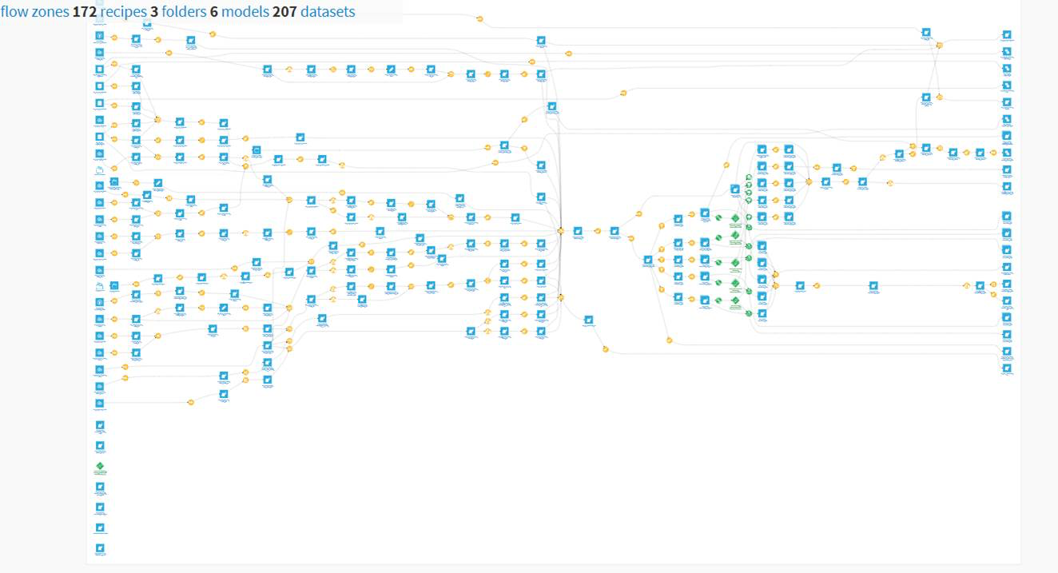

Slide 59
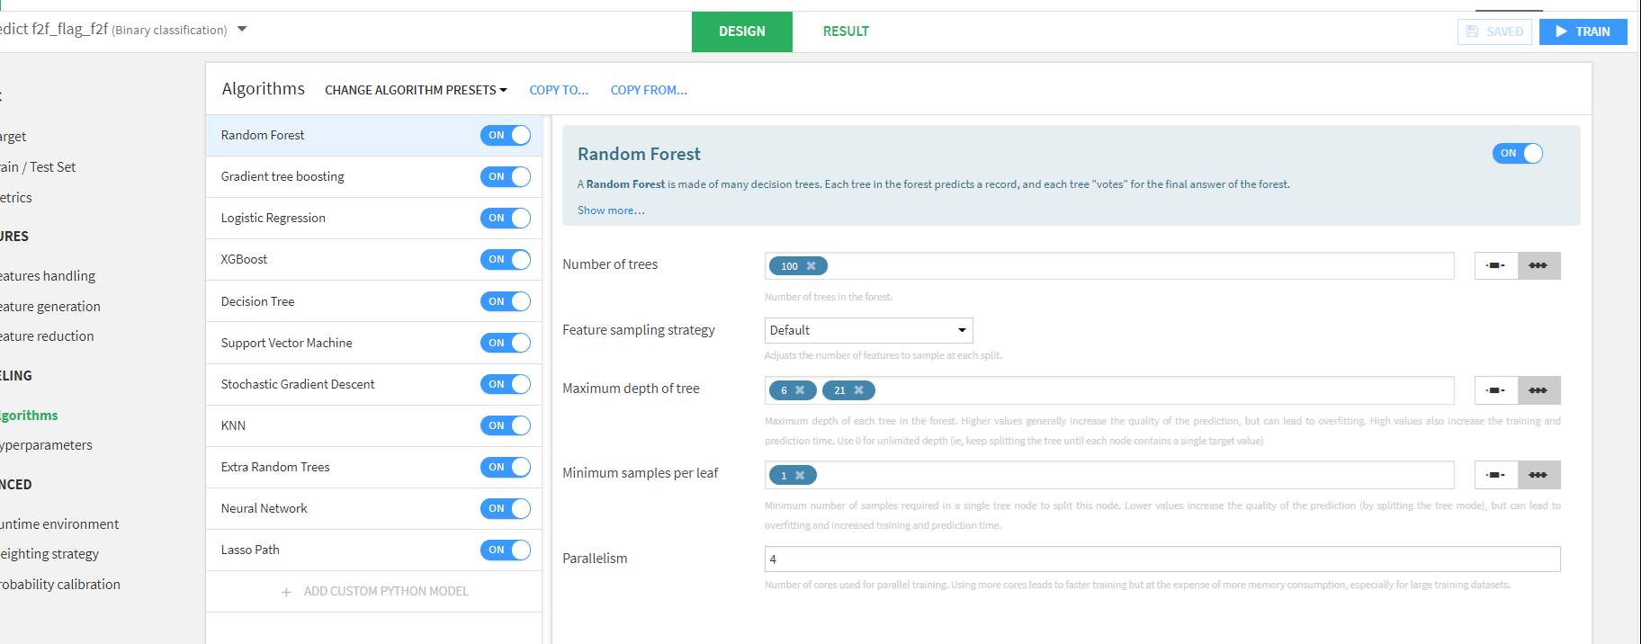

Slide 60
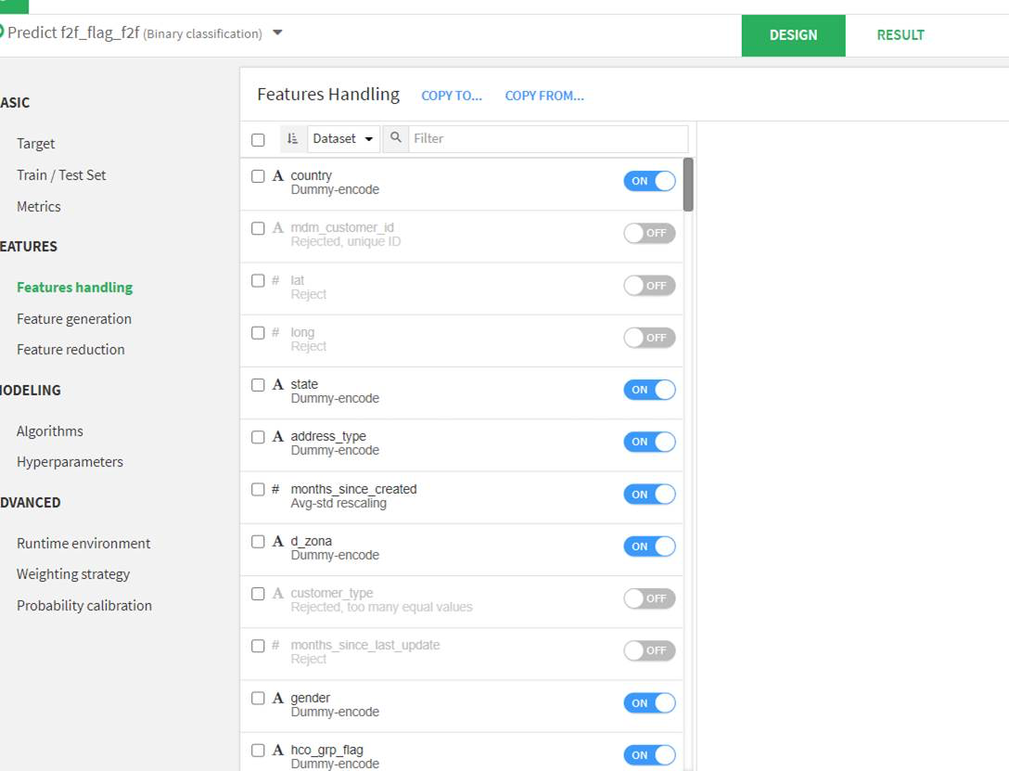

Slide 61
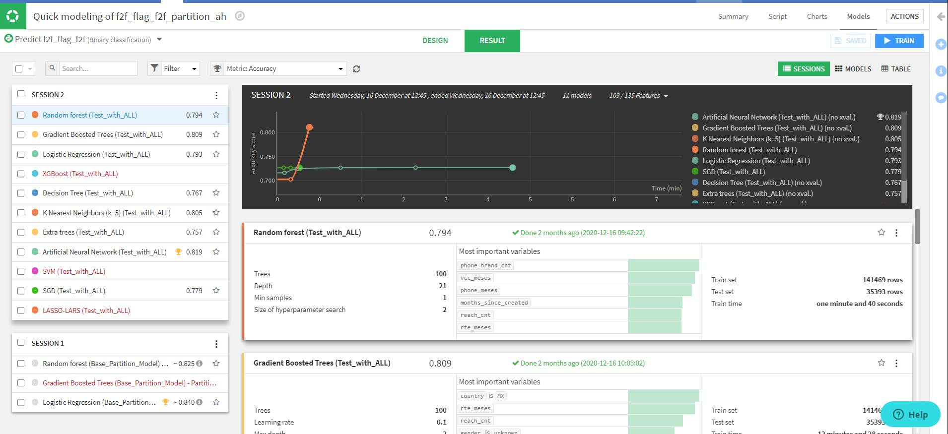

Slide 62
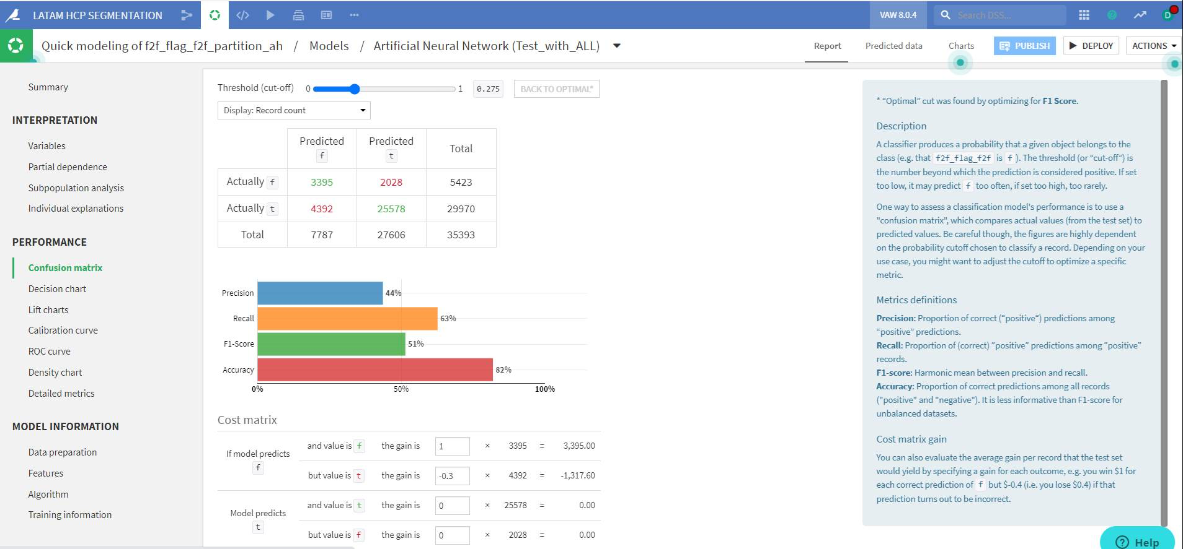

Slide 63
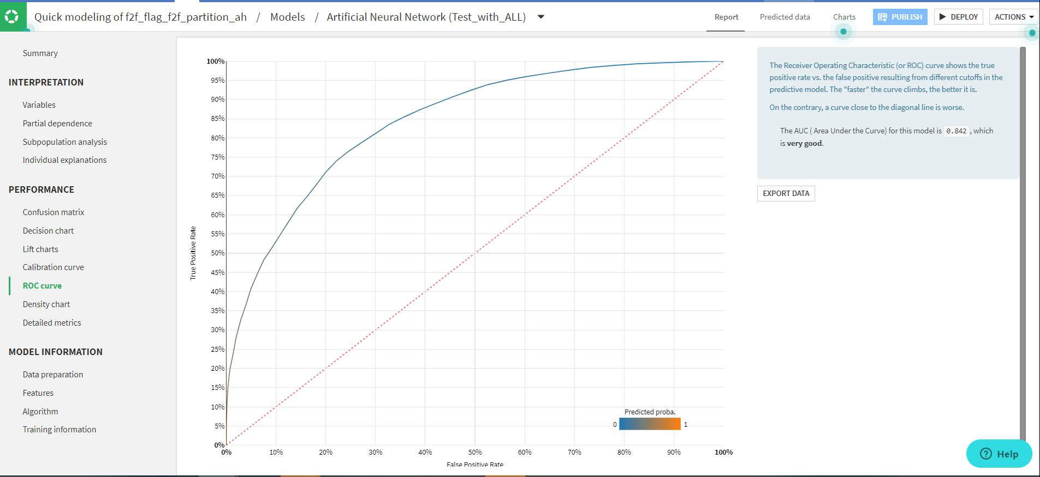

Slide 64
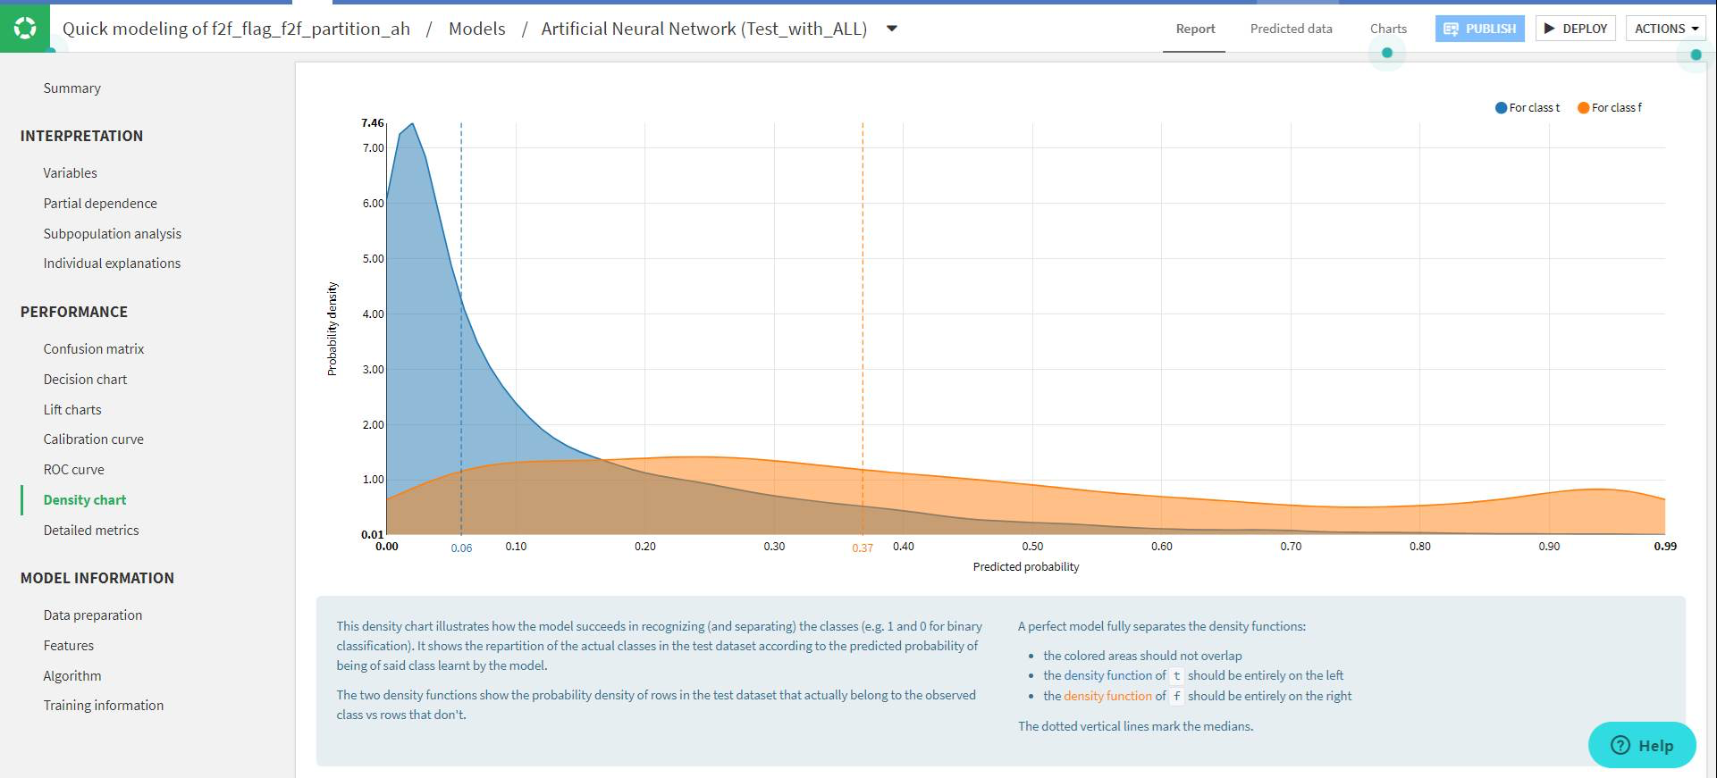

Slide 65
Try Easy ML free for 2 weeks
https://knowledge.dataiku.com/latest/kb/dataiku-cloud-offer/free-trial.html

Slide 66
Machine Learning Models in R
Model Name | Method
General Linear Models | glm
Linear Discriminant Analysis | lda
Quadratic Discriminant analysis | qda
K – Nearest Neighbor | knn
Random Forest | rf
Custom Random Forest | customRF
XgBoost | xgbTree
Support Vector Machines | svmRadial
Neural Networks | nnet
Boosted Tree Models | gbm

Slide 67
Code Structure Revision
# Regression and Classification Models
library(caret)
# Read data.
dataset <- dataset
#Spliting data as training and test set. Using createDataPartition() function from caret
select1 <- createDataPartition(dataset$diabetes,p = 0.80,list = FALSE)
trainset <- dataset[select1,] #AS train 314*9
testset <- dataset[-select1,] #AS test 78*9
# Resampling & Tunning specific to XgBoost
control <- trainControl(method = "cv", number = 5) # 5-fold CV
tune_grid <- expand.grid(nrounds = seq(from = 100, to = 1000, by = 50), #Number of trees, default: 100
max_depth = c(2:6), #Maximum tree depth, default: 6
eta = c(0.04, 0.05,0.06,0.07,0.08,0.09,0.1), #Learning rate, default: 0.3
gamma = 0, #Used for tuning of Regularization, default: 0
colsample_bytree = 1 , #Column sampling, default: 1
min_child_weight = 1, #Minimum leaf weight, default: 1
subsample = 1 #Row sampling, default: 1
)
# Modeling
xg_fit <- train(diabetes ~.,
data = trainset,
method = "xgbTree",
metric ='Accuracy',
trControl=control,
tuneGrid = tune_grid,
tuneLength = 10
)

